Slide 1
Numpy, pandas, matplotlib

Slide 2
Numpy
Numpy runs C/C++ under the hood and provides an array object that is up to 50 times faster than Python lists.
These are called ndarrays (n-dimension arrays).
Fixed datatype
Arbitrary dimensions
vectorized
For comparison, Lists:
Can hold mixed types
Don’t scale to multiple dimensions naturally
Aren’t vectorized

Slide 3
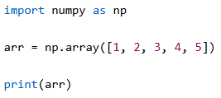
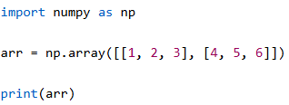
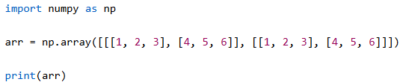



Arrays of multiple dimensions
<- check the shape ex:(2, 4)
<- check number of dimensions

Slide 4
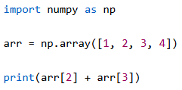
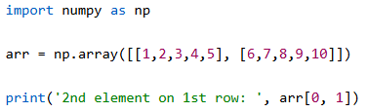
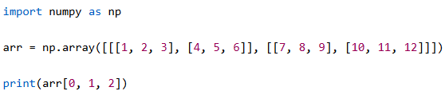
Data Access
Get an item just like lists:
Just kidding, here’s a 2-d array:
3-d array access:

Slide 5
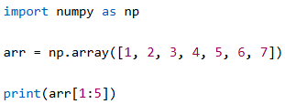
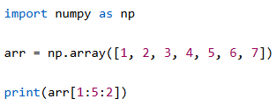

Slice & Steps
Slice an array:
Return every other element from index 1-5
Note: [inclusive start, exclusive end)
Return every other element in entire array:

Slide 6
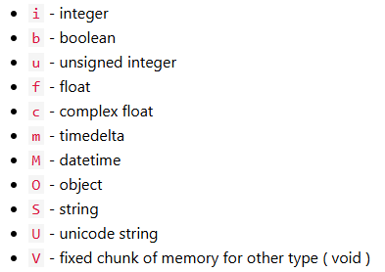
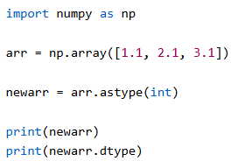
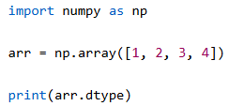
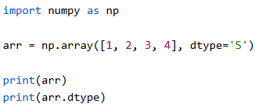
Numpy data types

Slide 7
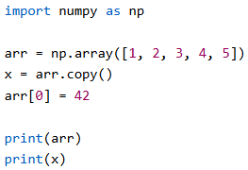
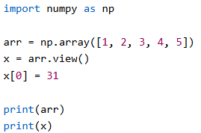
COPY vs VIEW
COPY receives a 1 for 1 copy. VIEW creates a pointer to same data buffer (not the same as memory address).
Note: arrays can be expensive in ML/Data Science. It’s often times easier and more performant to create different!

Slide 8
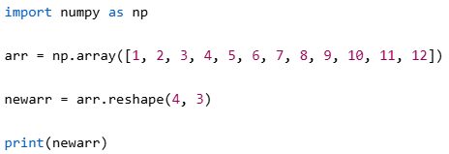
Reshape
[[ 0 1 2]
[ 3 4 5]
[ 6 7 8]
[ 9 10 11]]
[ 0 1 2 3 4 5 6 7 8 9 10 11]
—>

Slide 9
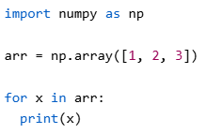
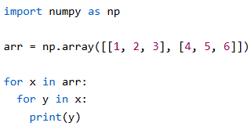
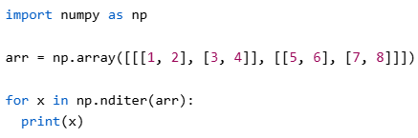
Iteration

Slide 10
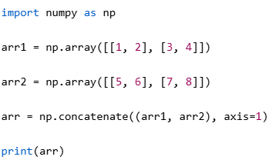
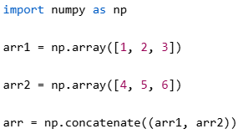
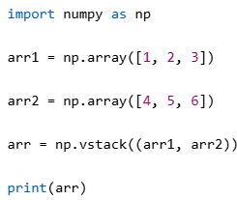
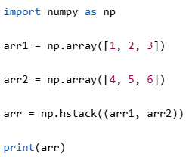
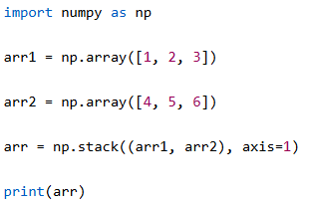
Joins

Slide 11
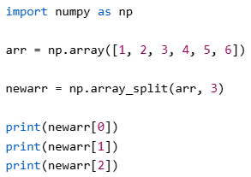
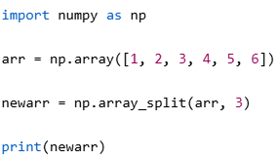
Split

Slide 12
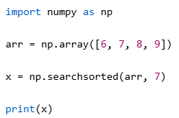
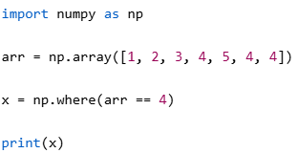
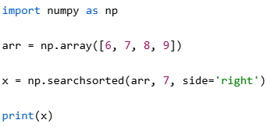
Search
Binary searches on sorted arrays ->

Slide 13
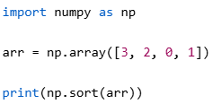
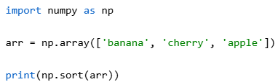
Sort
Sort will return a copy of the array!

Slide 14
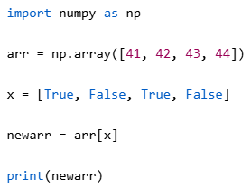
Filters/Boolean Masks

Slide 15
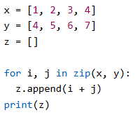
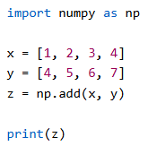
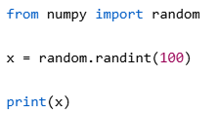
Random & ufuncs
There are many random methods:
Without & with universal functions:

Slide 16
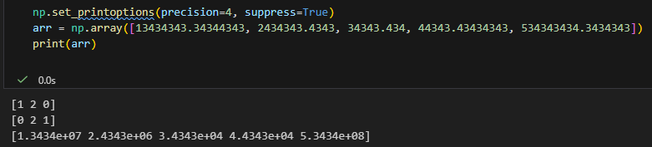
Format Numeric Output

Slide 17

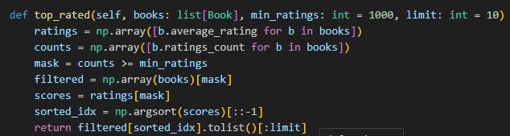
The power of numpy!
Pandas can replace the functionality of these (but tradeoffs exist):

Slide 18
Pandas
Pandas is a Python library used for working with data sets.
Pandas = “Panel Data” + “Python Data Analysis”
Find correlations between two or more columns
Find average values
Min/Max
Delete rows of bad or empty data. I.e. ‘data cleaning’

Slide 19
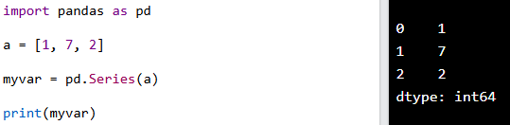
Pandas
Each series is like a column in a table ->

Slide 20
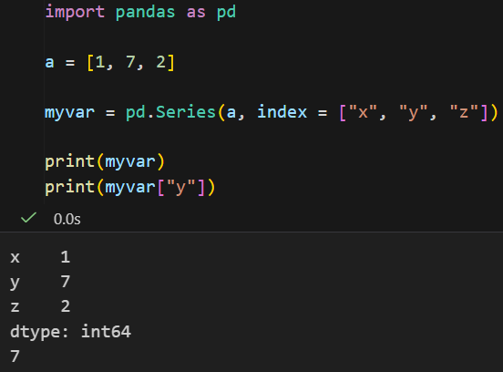
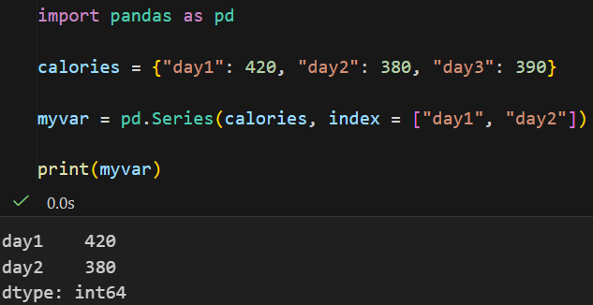
Labels

Slide 21
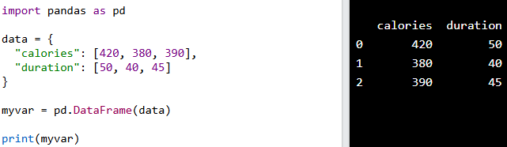
DataFrames
If a series is a column, then a DataFrame is the whole table:

Slide 22
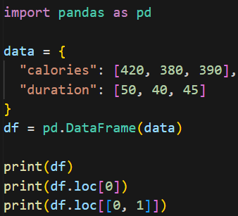
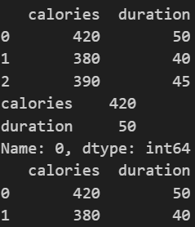
Selecting Rows
Note that a Pandas series or a DataFrame may be returned:

Slide 23
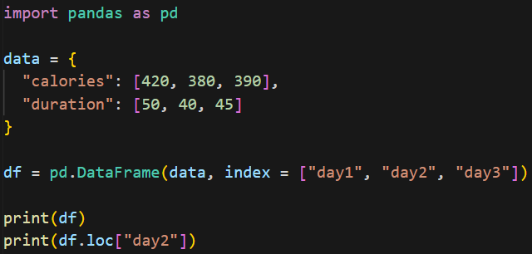
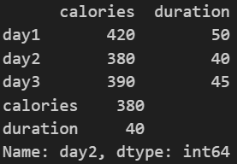
Naming Indexes

Slide 24
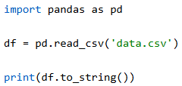

Read Data from Files (CSV)
If we have a large dataset, Pandas will only return the first 5 and last 5 records. Use to_string() to print the entire DataFrame
<- Pandas has built-in settings that alter its behavior. This will set the max rows a DataFrame must have, before it will cut off records in print statements.

Slide 25
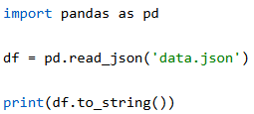
Read Data from JSON
JSON works similarly to CSV files
Sidenote: dictionaries can be loaded into Pandas directly

Slide 26
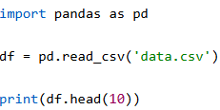
Heads or Tails?

Slide 27
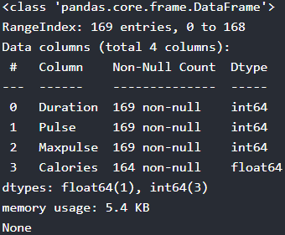
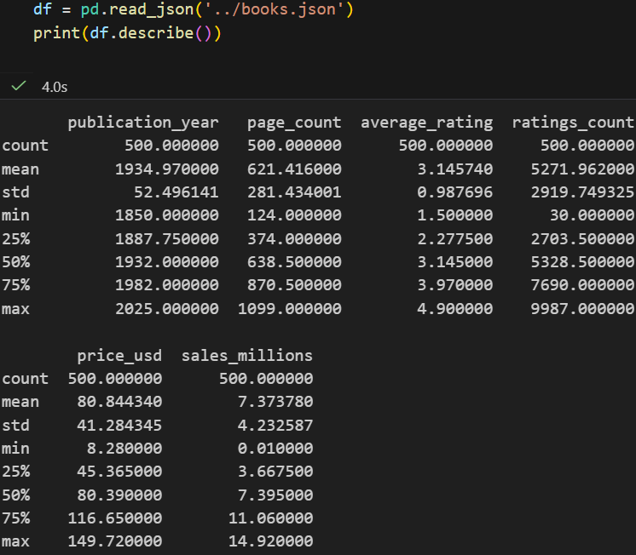
Info & Describe
The calories column has null rows!

Slide 28



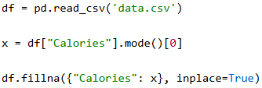
Cleaning Empty Cells
These methods only work if the field is NaN, None, or pd.na! I.e. empty strings skipped
Get a copy with no nulls:
Replace nulls with a value:
Alter original:
Replace only for a certain column:
Note: mean() or median() would also work here.

Slide 29



Cleaning Wrong Format
01282026
01/28/2026
01-28-26

Slide 30


Fixing Wrong Data
Set a specific item:
Loop through the DataFrame and conditionally change value:
Loop through and drop rows that don’t meet the conditions:

Slide 31


Removing Duplicates
Get booleans for any item that is a duplicate:
Drop any duplicates:

Slide 32



Data Correlations
1 = perfect correlation (1-1 movement)
-1 = perfect negative correlation (inverse movement)
0 = No correlation at all
corr() can only work with numeric types
Can also do this:

Slide 33

Filter/Sort Records

Slide 34
Challenge
Goal:
Clean data with Pandas
Details: ? min
Use the provided JSON dataset and complete the following:
Some string values may be, “” instead of null. Set these fields to NaN with numpy before you continue cleaning
Clamp publication year to the years of 1800-2026
Ensure average_rating, page_count, etc can’t have impossible values
Normalize dates in ‘last_checkout’
Ensure genres, languages, formats, and publishers have proper capitalization
Find and remove duplicate books with the same title/author
Drop rows with empty fields

Slide 35


Group By

Slide 36

agg()
Remember:
groupby() -> labels
agg() -> series/columns

Slide 37


Matplotlib
Matplotlib is a low level graph plotting library
Visualization utility
Open source
Written in python, c, Objective-C, and JavaScript

Slide 38




O vs marker=’o’
Marker Reference

Slide 39



Plotting Multiple Points
Both x, y:
Only y:
(x will increment automatically to meet y)

Slide 40


fmt, colors, lines
fmt = marker | line | color
ms = marker size
mec = marker edge color
mgc = marker face color
Line & Color Reference

Slide 41

Arguments
We’ve seen the shorthand, but many of the options have explicit arguments, such as linestyle/ls
color/c
linewidth/lw

Slide 42



Multiple Lines

Slide 43


Styling your Plot

Slide 44


Subplots
subplot(rows, columns, plot #)
We can add as many as we wish, just specify those three things
Aside from hspace, there is also, left, right, top, bottom, and wspace

Slide 45


Scatter Plots
Colormap Reference

Slide 46



Bar Graphs

Slide 47


Histograms

Slide 48



Pie Charts
The first wedge starts at 0 degrees and then wedges are laid counterclockwise.
Wedge size = x/sum(x)

